Slide 1
Software Requirements Specification Medical Service Center Prepared by Supervised by Md. Abdul Motin Md. Rajaul Islam ID : 1246494 Used Technology Java Swing,Jdbc,Netbeans & Mysql

Slide 2
Requirements Tarapur private clinic. Here is served higher treatment. There are experienced doctor & employee. At present they are trying to run there clinic digitally so they need a software.

Slide 3
Requirement analysis Doctor list Patient registration. Employee registration. Proper treatment. Pathology test. View summary.

Slide 4
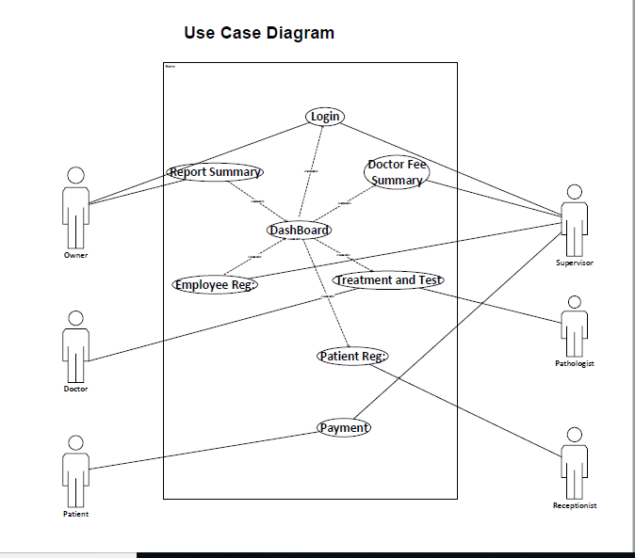

Slide 5
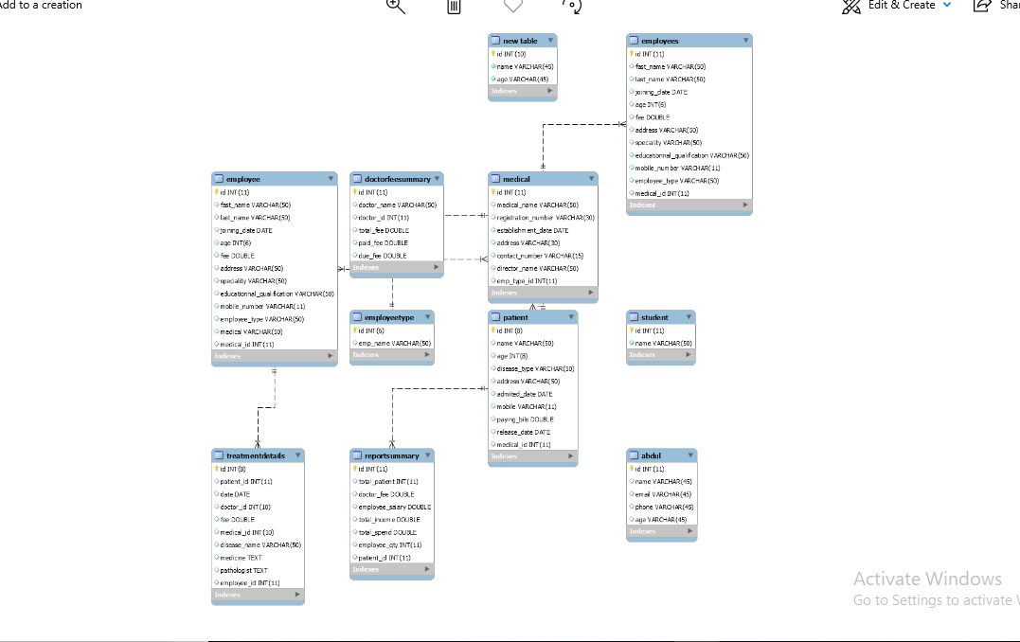
Class diagram

Slide 6
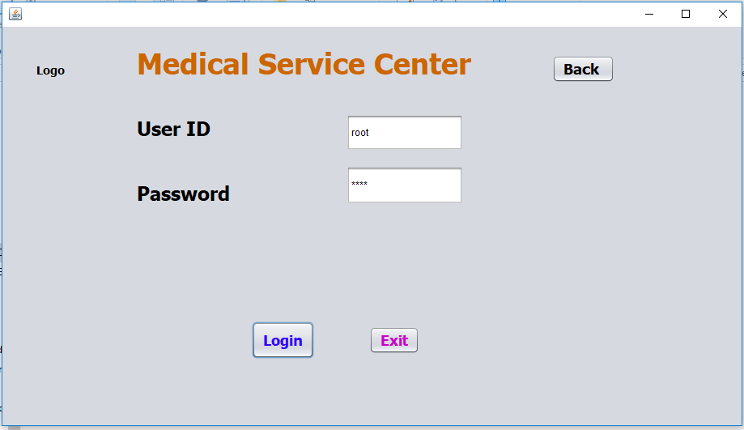

Slide 7
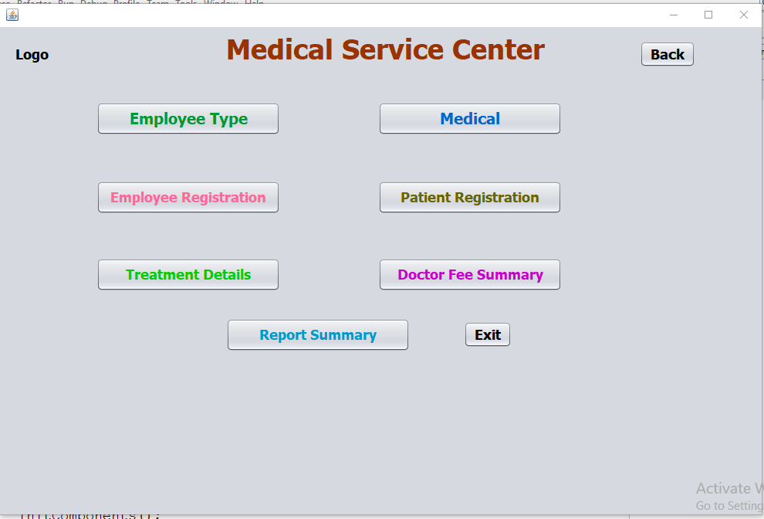

Slide 8
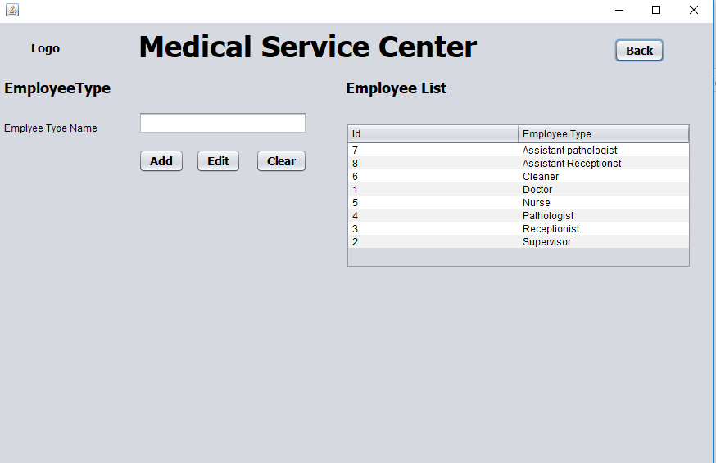

Slide 9
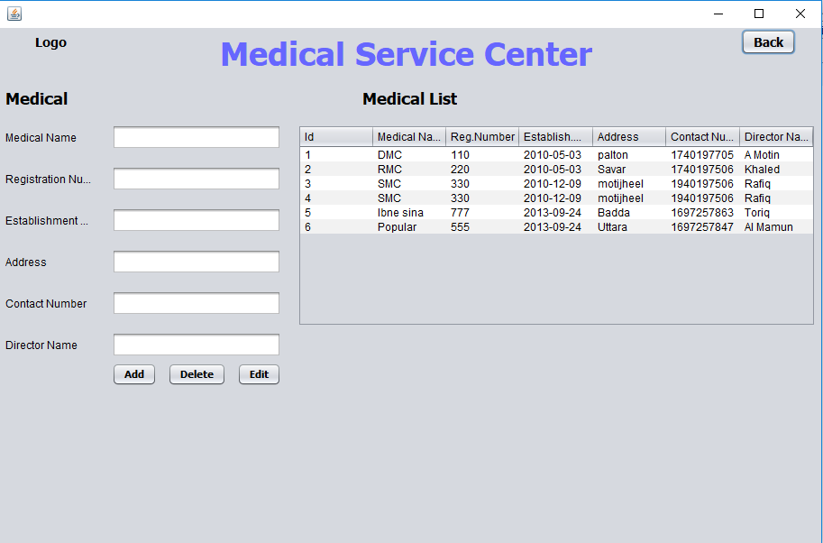

Slide 10
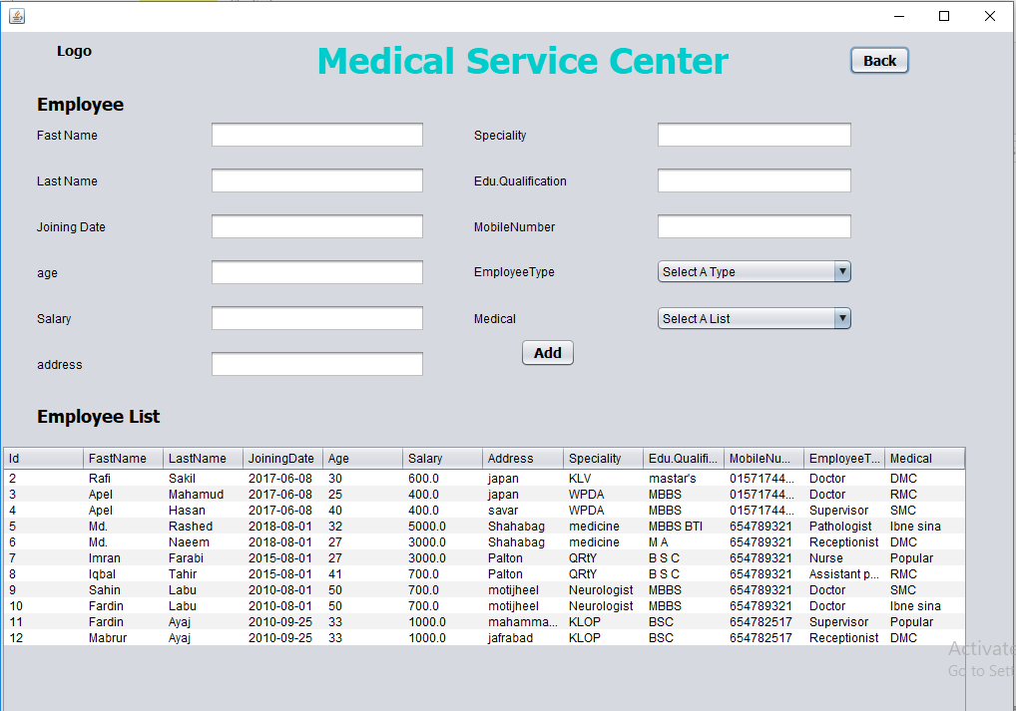

Slide 11
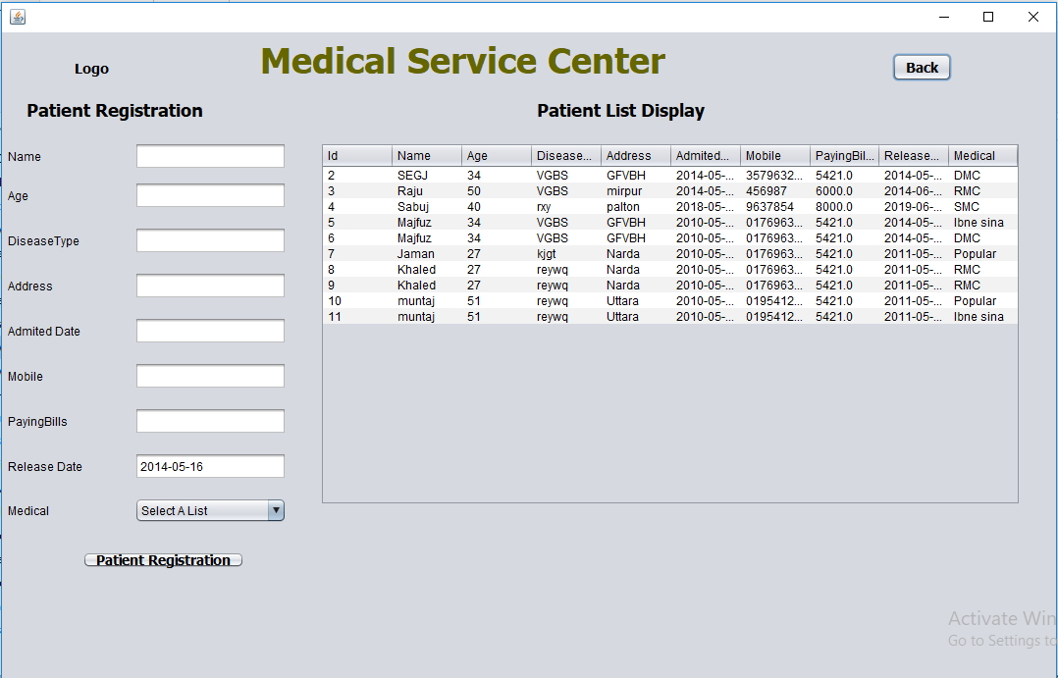

Slide 12
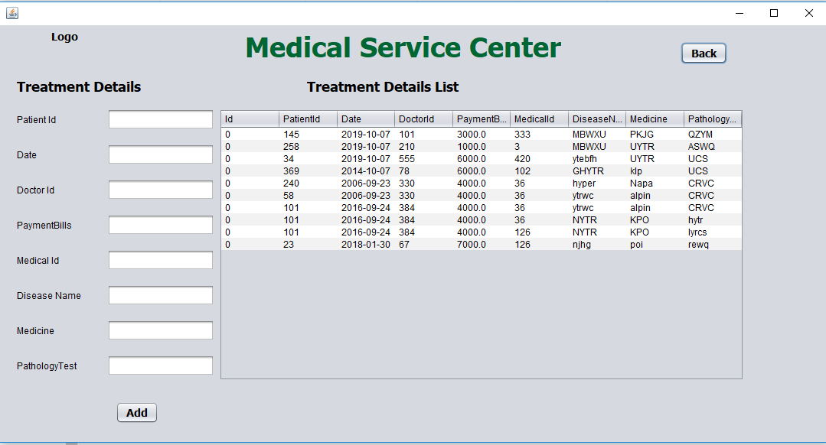

Slide 13
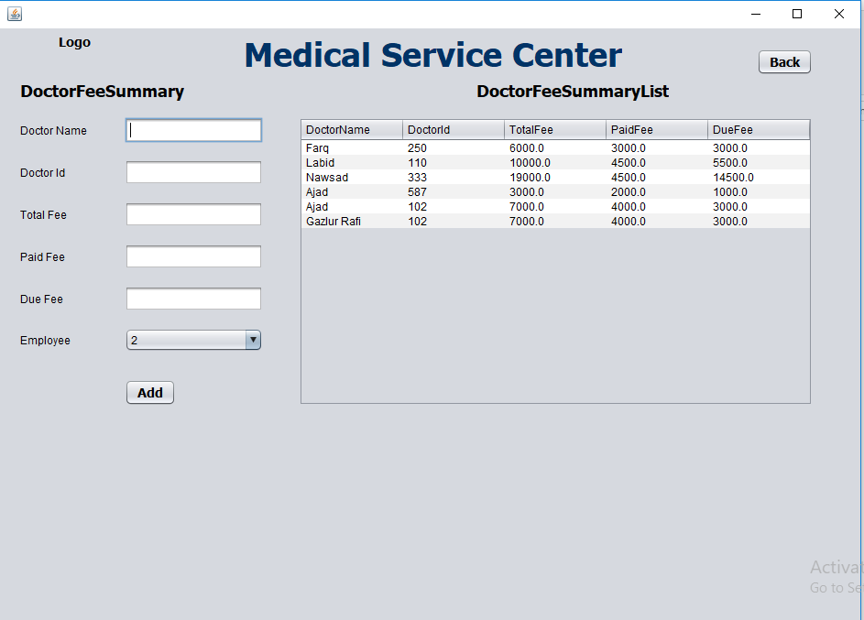

Slide 14
